Slide 1
FutureNow 3-week readout – Aug 20th

Slide 2














FutureNow working team
David Cardoza
Director – Process & Performance
Sonny Anand
Director – Resource Planning
Matt Reilly
Manager Portfolio Controls
Michael Mayes
DV Product Director
Matthew Sundberg
Principal
Matt Haering
Asset Management Engineer
Michael Falls
Asset Management
Vikas Kadam
Enterprise Architect
Dan White
National Grid Partners
Alejandro Fernandez
Consultant
Nick Lucking
Venture CTO
Tristan Mallet
Gamma Associate Director
Nalin Mello
DV Senior Engineer
Anmol Pareek
Platinion Architect
Mischella Jayachandran
Platinion Architect
National Grid
BCGDV
Notes:
TONY

Slide 3
Recap: Our target deliverables for the 9 week validation phase, with particular focus in our first 3 weeks
Product
Technology
Strong focus in first 3 weeks
Business & Operations
A
B
C
Current state & frictions
Including baseline costs, processes, user journeys
Build/buy recommendation
Assessment of build/buy options, and recommended path forward
Business / investment case
Quantification of the business value and investment requirements
Target MVP, product vision
Including visuals / prototype, feature descriptions, roadmap
Technical soln & feasibility
Technical solution hypothesis, assumptions & risk assessment
Operations soln & feasibility
Preliminary operations soln, assumptions & risk assessment
D
Validation pitch deck
Presentation to digital board, go/no-go for build vs. buy phase
Detailed MVP phase plan
Including team, piloting strategy, transition plan

Slide 4
We are 3 weeks into the validation phase
Focus questions to make progress on in first 3 weeks
Expectations for today
What is the IT & data landscape supporting the planning process? What are the assets? Gaps? Issues? Constraints? What are the implications for our FutureNow MVP?
Our objectives for today
Share updated view on FutureNow product vision & target MVP features, including rationale for prioritization
Share 3 week status on IT & data landscape assessment
Align on business case value levers for MVP
Provide an update on 'Build vs. Buy' assessment, confirm top 5 options
Confirm next steps & plan for remaining 6 weeks of validation phase
1
Share our synthesis of plan process & IT/data frictions
What is the current process & frictions that FutureNow needs to address?
2
Get your input on initial FutureNow product vision
3
Discuss potential MVP options for FutureNow
Your input needed:
What are our initial hypotheses for a FutureNow product vision & MVP?
Considering frictions, IT& data landscape, value generation?
Alignment on approach to prototype and test against hypotheses
Input on business case and value drivers
Alignment on plan of attack over next six weeks to validate FutureNow

Slide 5
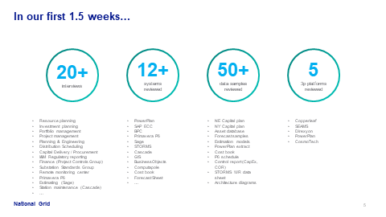
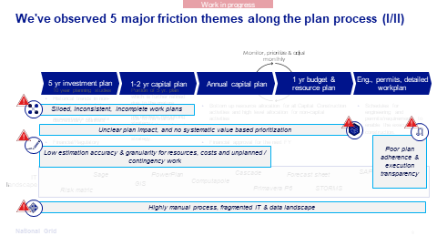
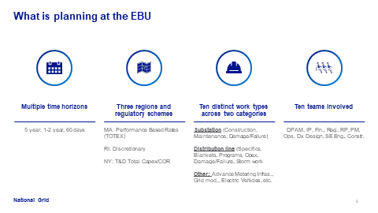
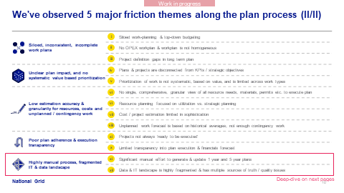
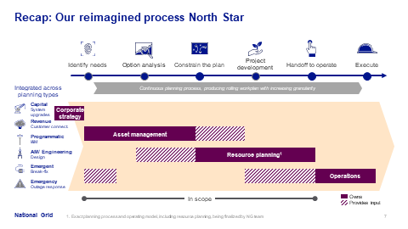
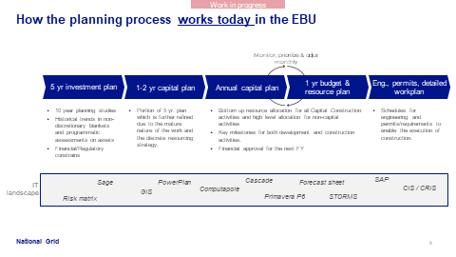
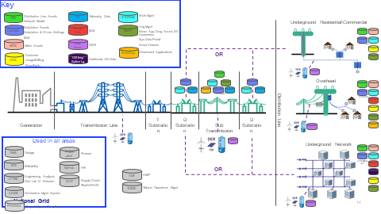
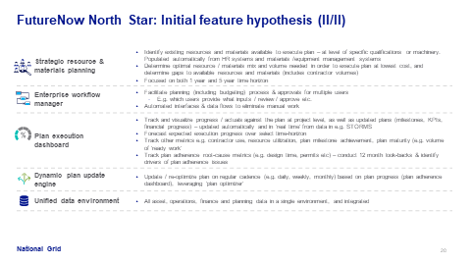
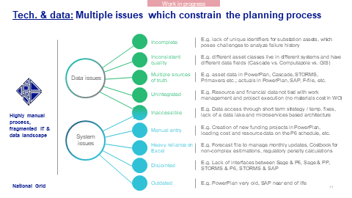
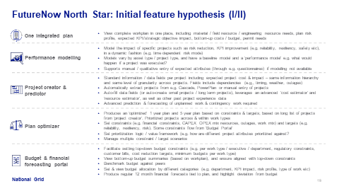
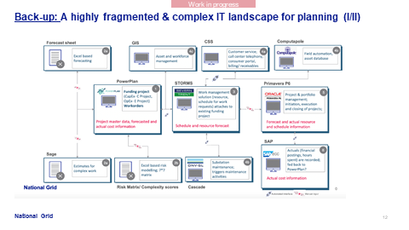
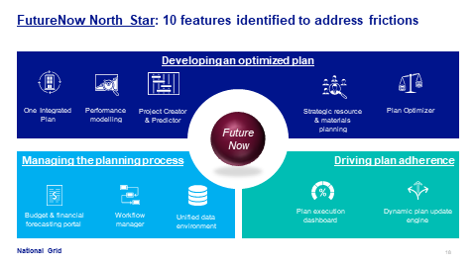
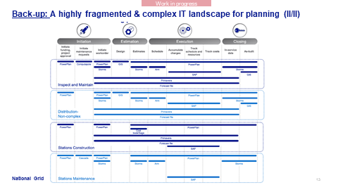
Recap: last week's Demo
1. Current State Process
2. Frictions
3. Data & IT landscape
4. North Star & initial MVP hypothesis

Slide 6
FutureNow product

Slide 7
Recall: Five core EBU planning frictions
Siloed, inconsistent, incomplete work plans
Unclear impact, and no systematic value based prioritization
Low estimation accuracy & granularity for resources, costs and unplanned / contingency work
Poor plan adherence & execution transparency
Highly manual process, unclear accountabilities and a fragmented IT & data landscape

Slide 8
FutureNow North Star: We've designed a vision to address core planning frictions
North Star Feature | Siloed, inconsistent, incomplete work plans | Unclear plan impact, and no systematic value based prioritization | Low estimation accuracy & granularity for resources, costs and unplanned / contingency work | Poor plan adherence & execution transparency | Highly manual process, unclear accountabilities and fragmented IT & data landscape
One Integrated Plan
Performance analysis
Project Creator & predictor
Plan Optimizer
Strategic Resource & materials planning
Budgeting & financial forecasting portal
Enterprise workflow manager
Unified data environment
Plan execution dashboard
Dynamic Plan update engine

Slide 9
Fifth dimension added to narrow FutureNow MVP scope Work type decision critical to focus
MVP design dimensions
MVP evaluation criteria
1
Features
Desirability Does it matter?
Frictions, why now, purpose
Is this something we need, do users want it, is it aligned with the NG vision and mission
Discretionary, non-discretionary
One Integrated Plan
Performance analysis
Project Creator & predictor
Plan Optimizer
CAPEX: Specific, Program, Blanket
MVP
D-line / Substation
OPEX: Maintenance, Storms, etc.
Viability
Can we win?
Is there a business model and value for NG?
Can we roll it out to the organization effectively?
How will it fit into the operating and partner ecosystem?
2
Type of work
Multi-factor scoping decision to filter to a subset of work
MA NY RI etc.
3
Region
Feasibility
Will it work?
What is the product/solution
Is there outside competition/ oppty to buy instead of build
What is the technical complexity to deliver in a reasonable timeframe?
4
Time horizon
<1yr
1-2yr
5yr
Core of last three weeks
NEW
5
Constraints to optimize against (financial constraints/ budget, CAPEX OPEX mix, resources, outages, work mix) and targets (e.g. reliability, resiliency, risk)

Slide 10
Our preliminary MVP hypothesis
Work in progress
Dimension | MVP hypothesis | Why? | Confidence Level
Features | Performance Analysis Work Plan Optimizer Project creator One integrated plan | 80% (TBC) of value generated by perf. analysis and work plan optimizer Other features required to support work-plan optimizer Focused user scope: project prioritization and risk mgmt | High
Type of work | CAPEX work for sub-stations & distribution line core (reliability) work: Focus on programs, specific projects | Highest quality data in sub-station, majority of work is CAPEX Reliability significant value driver & room for optimization All reliability work in order to support holistic optimization (e.g. work-type trade-offs) Oppty to leverage existing / in-progress substation risk modelling; Harmonize across teams Can leverage and incorporate best-in-class examples from other utility businesses Blankets incl. VMO work and emergency must-do | Low (sprint next week)
Region | MECO (Massachusetts Electric Company) (TBD focus on S or W division) | TOTEX regulatory environment Regional focus reduces complexity and avoids process / regulatory differences Discretionary and non-discretionary managed as a whole | High
Time-horizon | 2 year plan (12 month plan + second year of 5 year plan) | Ensures high priority projects enter the 12 m plan Reduced complexity compared to doing 5 year plan Higher likelihood of granular | High
See next page
1
2
3
4

Slide 11
Performance analysis: Strong NG starting point to build on
Draft for discussion
1
NG's starting point
Key to build on it for MVP
Asset maturity team have started on risk modelling journey, towards ISO 55000
Developed project impact / criticality framework focused on substations and T-lines
All manual except network criticality. Aiming to make it more data-driven
Risk / predictive asset health models developed for targeted critical asset classes
No asset health models for D-lines. Criticality framework definition for D-line at the start of a journey
Defined integrated risk scoring to assess risk impact of changes in capital portfolio. Not currently planning to use as single project prioritization framework
Ideas on how MVP could build on these efforts:
Selectively enhance existing models, e.g., improve analytics, automate data input
Rapidly implement simple D-line network importance model and/or failure/asset health model as part of the MVP, start with prototype
Provide a harmonized prioritization framework for projects across substation & D-lines
Jointly integrate FutureNow and existing roadmap to prioritize / accelerate key aspects
Specific hypotheses to be narrowed down and tested in the validation phase

Slide 12
IT & data landscape

Slide 13
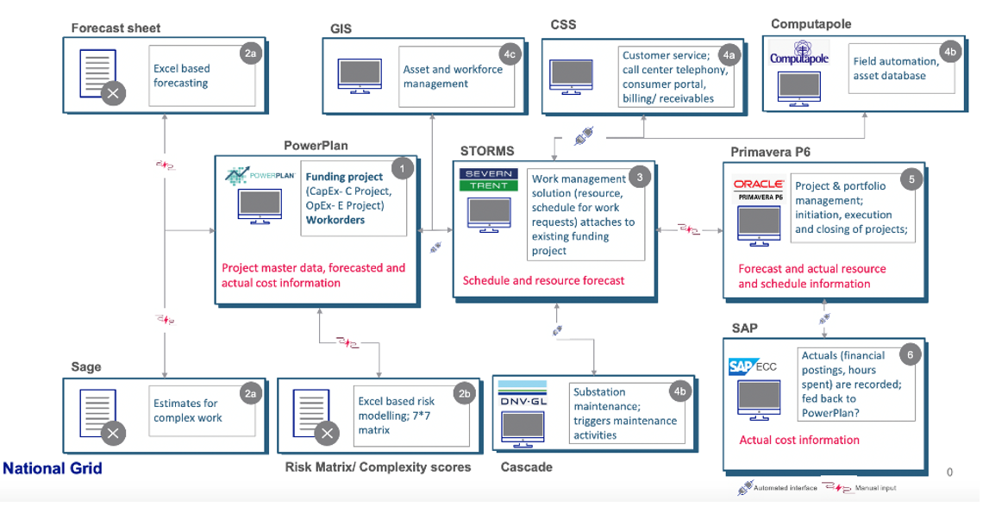
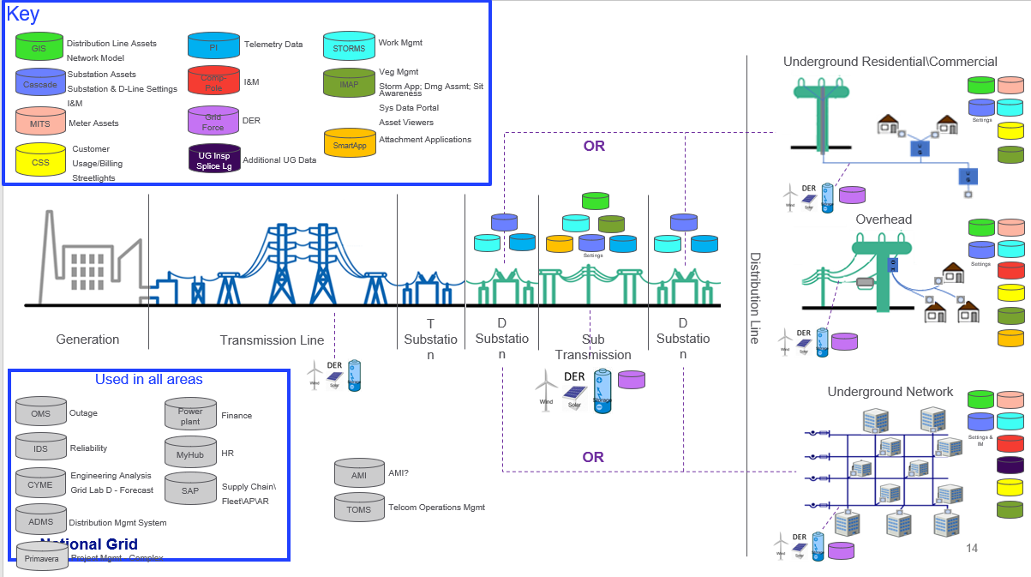
IT & Data assessment
Assessment purpose is to answer key questions
What we have done
What is the IT and data landscape that supports today's EBU planning process? What are the overall frictions & challenges?
Information architecture
Existing interfaces / APIs
Location of data fields
Is data quality sufficient to support MVP features? E.g.
Multiple sources of truth, unstructured, stored in excel, inconsistent taxonomy, user entry error, completeness
Is data accessible for prototype & MVP data platform development? System access?
What MVP tech implementation challenges & constraints need to be actively managed?
E.g. security approvals, SME access, environment access, IT stability issues
Mapped information & enterprise architecture support planning process
Developed initial IT / data requirements for MVP
Mapped MVP feature sets against relevant data domains / specific fields; identified key associated source systems
Assessed data availability, completeness and quality across key systems (interviews, documentation review, sample review...)
Assessed key constraints in terms of systems access, interfaces
Detail MVP technical solution & Continuously iterate with other streams of work (value, product...)
Deep-dive data assessment for data fields specific to MVP definition (data request launched)
Continue SME interviews on as needed basis
i
Next steps
ii
iii
Today's focus

Slide 14
Recap: Multiple challenges across the current EBU planning IT & data landscape
Examples
Incomplete
Incomplete cost data makes it difficult to track spending at a granular level (in Storms, P6, and Power Plan); Incomplete reliability data makes it difficult to analyze root cause of outages, such as transmission outages impacting substation / distribution outages
Inconsistent quality
Different asset classes live in different systems and have different data fields (Cascade vs. Computapole vs. GIS); tendency to shortcut data entry after work completion (>95% are "as per design")
Outage information (transmission, substation, and distribution are tracked in multiple systems; manual entry in some systems causes data inconsistency
Data issues
Asset data in GIS, Asset Data Warehouse, Cascade, STORMS etc.; actuals in PowerPlan, SAP, F-file, etc.
Reliability data in GIS, IDS, OMS, and excel file Financial Data in SAP, PowerPlan, BPC, Forecast File, P6.
Inspection Data in INM, Cascade, Storms, GIS, ADW.
Project Planning data P6, Storms, PowerPlan, Forecast File
Multiple sources of truth
Unintegrated
Resource and financial data not tied with work management and project execution (no materials cost in WO)
Actual cost charges & estimates are not integrated in one view – Storms has estimates & not charges, PP has charges & does no have estimates
Inaccessible
Data access through short term strategy / temp. fixes, lack of a data lake and microservices based architecture
Storms data lie in 100s of tables and no ER model available to explain the relationships. Cascade database is managed by a 3rd party data updates are manual process driven and time consuming.
System issues
Manual entry
Creation of new funding projects in PowerPlan, loading cost and resource data on the P6 schedule, etc. Transmission reliability data is loaded in excel or input by call center when the outage happens resulting in some key missing information
Heavy reliance on Excel
Forecast file is used to manage monthly updates and manually updated back into the systems. Costbook for non-complex estimations, regulatory penalty calculations, BPC budgetary constraint
Disjointed
Lack of interfaces between STORMS & P6, STORMS & SAP, Sage & P6, Sage & PP for an integrated cost planning, forecast, estimates, and tracking chargebacks
Outdated
P6 old, SAP near end of life

Slide 15
Learnings & MVP implications from the IT & Data assessment (I)
Preliminary
Key questions
Learnings
Implications for MVP & next steps
i
Is data quality sufficient across MVP features?
For building holistic portfolio view:
Key systems identified (Storms, Powerplan)
Covering the key fields needed (scope, cost)
No major data quality issue reported
Have strong source of truth for portfolio view
Very granular information available if needed, e.g., packets in Storms
For modelling project value:
Key systems identified (Cascade, IDS...)
Distinct data quality levels, from low to high (e.g., Cascade high, distribution outages low)
Several performance models being built by NG, but not covering the full scope and often manual
Key to leverage ongoing work from NG, e.g., built-in data (e.g., as-is from Cascade), existing models (e.g., ADA tool) - mostly for substations
D-line and in particular reliability, are more of a gap with disparate data sources and uneven quality / completeness. Need to identify best sources & gaps
Deeper exploration of Data Warehouse required incl. to narrow down existing gaps
Across both features
Lack of an entity model across enterprise
Lots of manual interventions, fragmented process causing quality / completeness issues
Have not yet assessed data quality with hands-on manipulation, beyond samples (e.g., P6)
Need to build linkages across data domains to get integrated picture
Need to conduct deep data quality assessment for priority data sets in next 6 weeks
Opportunity to embed data best practices in MVP phase & identify priority quality improvement options

Slide 16
Learnings & MVP implications from the IT & Data assessment (II)
Preliminary
Key questions
Learnings
Implications for MVP & next steps
ii
Is data accessible for prototype & MVP data platform development?
Data for FN is spread across diverse and disparate sources, systems, incl. Power Plan, Storms, Cascade, P6, SAP...
Several data in Excel, e.g., reliability information, financial forecast, risk score
Multiple systems to be accessed, with distinct pathways (direct, through DWH...)
Data access layer is built off of a mix of tools, some new and others outdated which need integrated
No blocker identified so far but actual access to be secured
Short term:
Will work with data dumps for prototype dev. for PP, Storms, Cascade, P6, SAP
Need to secure direct DWH access for other asset data
Medium term, need for selective direct access to systems for MVP support and data lake creation
require system owner and 3rd party participation for quick turnaround data support:
Need support from range of process owners, system owners, as well as 3rd parties for design & execution
iii
What tech implementation considerations must be actively managed?
Stable IT landscape, no major scope upgrade with exception of Unifier and potentially P6
Many learnings from OMW & Nucleus on technical feasibility & risks, e.g., Mulesoft, contractors
Logistically, number of constraints to tackle in the near-term, e.g., laptops, access, infra.
Key to anticipate technical bottlenecks vs. our roadmap and address them early
Ongoing engagement with the weekly IT PMO tracking process and support on the NG side

Slide 17
Data quality: For FutureNow MVP, we identified a map of relevant data fields and IT systems
i
Workplan Optimizer – Project source
Performance Analysis
Workplan Optimizer – Constraints source
Power Plan
Storms
GIS
Cascade
IDS
Primavera
SAP ECC
Funding Project:
Description
Status
Asset Location
Business segment/ department/ division
Estimated initiation/ completion/ in-service date
Initiator details
Classification
Risk
Impact
Justification/ spending rationale
Class code
…
Work Request:
Description & work packet details
Requirements/ CAD attachments
Schedule start & end date; actual start & end date
Crew ID/ Contact person/ Location
Operation details
Status
Resource assignment
Labor hours
Charges
Demographic
Estimation of Cost
Difficulty Level
Asset:
Device attributes
Equipment description
Location (GPS coordinates)
Asset type/ age
Opco ID/ description
Feeder & substation details
Manf. Details
Inspection & outage details
Asset hierarchy (parent device ID)
Structure attributes
Conductor attributes
Manufacturer details
Asset Topology
Asset Health
Condition Data
Actual asset maintenance History
..
Substation Equipment :
Description
Source
Manufacturer
Location
Age
Criticality, Health, Risk
Equip Category
Equip Class
Status
Equipment Description
Equip Position
Poweplan Accounting Number
Install Date
Maintenance Notes
Asset Group
Asset Type
rating
…
Reliability Data
Data Time and Location
Outage Location
Outage Device
Customers Interrupted
Outage Cause
Restoration Steps
Project Cost
Actual Cost
Aggregated Cost
Schedule based SAP Cost Element data changes
Schedule based SAP Activity Operation data changes
Schedule based SAP Actual Cost data changes
Funding Project:
Description
Status
Asset Location
Estimated initiation/ completion/ in-service date
Computapole
Work Order:
FP linkage
Description/ type
Status
INM Details
Inspection Time
Inspection Type
Measurements
Inspection Schedule
WBS:
Project Category
Funding project ID
WBS details
WBS subtype
WBS identifier
Project Type and value
Description
Milestones
Tasks & activities
Estimated and actual start & end date
Resource details
…
Work Order:
FP linkage
Description/ type
Status
Opco ID
AFUDC start/ stop date
Asset location
Budget/ spending rationale
Business segment/ department/ division
Estimated initiation/ completion/ in-service date
Project manager/ engineer/ STORMS job owner
USSC#
Class code
Actual Cost
…
Work Type:
Description
Type Code
Job Type
FP Scheduling Priority
Job Ownership
Scheduler Color code
Material list
Project details:
Project description
WR design status
WR design
Design details
Work packet
…
Work Order:
Resource Planning
Work order estimates
Work order actuals
WO Status
OMS
Estimates:
Construction Units
Financial estimates
Emergency Project
Map of the Grid
Controller Center Data
Outage Map
I&M data:
Health score of assets
Maintenance List
Maintenance Priority
…
Customer and billing
Contractor Information
Additional Contact
Interface Configuration
Distribution Energy device:
Topology
Type, Vendor
Location
Interconnection
Usage
…
Aggregated Cost (actuals):
G/L account details
RSRC Details
UDF Value and Type
Expense- activity mapping
…
Design data:
CAD designs
Construction sketch
Data Extract
Data Extract
Asset Data warehouse
Data Extract
Asset Data warehouse
Data Extract
Data Extract
How data will be accessed for MVP
High Data Quality
Medium to High Data Quality
Medium Data Quality
Poor Quality
Note: Data Quality is based on interview and data sample extracts, pending data assessment

Slide 18
Addressing data quality issues will require injecting short term fix and longer term focus – Example levers
Work in progress
 | Process & governance | Product | Analytics
Short term (MVP): Inject direct data fix | Clearly identify & leverage the actual source of truth from across multiple systems, e.g., estimates in Storms vs. Powerplan | Develop data dictionaries and clear linkages across systems, e.g., project tracking ID, WO | Develop aligned business rules to substitute absent data, connect data..., e.g., work breakdown structure details
 |  | Build features to clean / complete data gaps as FutureNow product is used | Detect outliers to remove errors, broken entries, etc. and sanity check key data sets, e.g., sub-totals, variance, evolution for project budgets
Longer term: Support use case scale up | Upgrade data collection practices, e.g., in field inspections, in business processes like maintenance | Develop reference frameworks and scales to ensure data calibration and improve over time, e.g., risk model consistency | Mine text, e.g., leveraging natural language processing, to collect, interpret, classify data such as maintenance records
 | Ensure ongoing alignment with data domain owners (asset & functional) | Learn from key data discrepancies and echo improvement brought to the broad organization, e.g., track actuals & use for future planning | Develop feature engineering to increase performance of models, e.g., network performance data
 | Share best practices, toolkit and data referential across siloes, e.g., standardize across different planning time horizons

Slide 19
Business case

Slide 20
FutureNow North Star benefits
Financial benefits
OPEX/CAPEX efficiency (more KPIs achievement per $) or headroom creation
Bonuses or avoided penalties (e.g. EAMs, reliability) for achieving / exceeding KPIs
Improved rate-case outcomes (e.g. CAPEX/OPEX ratio)
Reduced material and contractor spend (procurement benefits)
Planning process efficiency (resource productivity)
A
Financial
Non-financial benefits
Improved grid reliability and resilience
Greater customer satisfaction
Improved safety & reduced environmental impact
Faster execution of new programs (headroom): DER / EV penetration and grid modernization
B
Non Financial
Strategic
Strategic benefits
Improved relationship with regulator, including 'cost:benefit' discussions, removal of minimum work volumes requirements (e.g. I&M NY)
Achievement of US strategic Objectives
Branding and Corporate impact
C

Slide 21
Financial benefits: Future Now generates benefits through 5 levers
MVP focus
A
Vision Feature
Value lever
Specific direct financial benefits
MVP focus
One Integrated Plan
Performance modelling
Project Creator & predictor
Plan Optimizer
Strategic Resource & materials planning
Budgeting & financial forecasting portal
Enterprise workflow manager
Unified data environment
Plan execution dashboard
Dynamic Plan update engine
Greater planning efficiency
Create & update the plan with fewer resources & time
Improved regulatory outcomes
Better OPEX / CAPEX ratio for long term plan
Greater performance bonuses
Minimum work removal
Greater plan accuracy & completeness (cost, resource, materials)
Material / inventory optimization (e.g. procurement)
Resource optimization (e.g. in-source / outsource)
Plan optimization
Bonuses or avoided penalties (e.g. EAMs, reliability) for achieving / exceeding KPIs
OPEX / CAPEX reduction (or headroom creation) while achieving KPIs
Improved plan adherence

Slide 22
Financial benefits: Quantifying financial value pools of MVP features
A
Lever | Benefit | Calculation | Quantification approach
Greater planning efficiency | Create & update the plan with fewer resources & time | Total estimated # of hours spent on each step of planning process less estimated time / resource savings from MVP features (hypothetical) | Headcount / man-hours baseline (survey) Estimate specific wastage in process & potential efficiency improvements from MVP features (survey)
Plan Optimization | OPEX / CAPEX reduction (or headroom creation) while achieving KPIs | Estimated CAPEX and OPEX reduction % per work & asset type without increasing operations risk multiplied by specific CAPEX and OPEX spend baseline Taking into account regulatory differences across regions | Triangulation of: EBU peer benefits achieved though AIP & APM implementations MVP prototype results Asset management retrospective estimation: % of work considered low/non-critical (remove) Critical work that should have been completed (add)
 | Penalty reduction for exceeding / achieving KPIs | Average penalties over past five years | Aggregation of regulatory metric penalties
Two tiers of benefit: (i) constrained by resources, minimum work levels, etc. and (ii) unconstrained

Slide 23
Our starting point: Baseline for EBU FutureNow
A
$1,342M
$727M
Distribution Line ($M)
$274M
Substation ($M)
Specific
Distribution Line
Substation
Distribution Line ($M)
Other
$140M
Totex Budget
FY21¹
Capital Plan
FY21
Substation ($M)
25
OPEX
Specific
Program
Cap related OPEX
Program
Distribution Line
0
0
COR
Blanket
Substation
Asset Condition | Customer Requests/ Public Requirements | Damage/ Failure | System Capacity & Performance | Other
Indirect CAPEX
Reserve
Other
Direct CAPEX
1. Direct CAPEX and COR based on Capital Plan, Indirect CAPEX and OPEX based on budget reports Source: NG Internal reports
Spending rationale

Slide 24
Build vs. buy

Slide 25
Our framework to assess Build vs. Buy
Product
Technical
Financial
Strategic
Solution/feature fit
For vision
For MVP
EBU Work types
Degree of change needed to existing processes
User interface
Implementation approach:
Timeline
Speed
Agile roll out
Modularity
Dev effort
Customizability
Data maturity needed
Deployment flexibility
Security/compliance, NG IT Policies
Engine Performance
System integration
Data extract
Infrastructure model
Asset reuse / extensibility
Non-functional requirement support
Scalability
Engineering resource availability / cost
License model
Licensing costs
Development costs
Support headcount / costs
Vendor size
Vendor history (foundation date, known clients, growth trajectory, staying power, etc.)
Industry experience
Past NG experience with vendor
IP ownership (Company vs. Vendor)
Vendor lock-in
Data strategy (will the solution unlock data to support ML/AI initiatives)
Capabilities developed for future Digital Products
New criteria since OMW
Key criteria

Slide 26
Our approach to build vs. acquire is not binary
We look at each layer of the solution stack…
…and at the different ways to execute over time
Value captured
North Star
User interface
Business / Domain
1
Data Base
3
2
5
4
Core systems Integration
Option 1 – Pure build
Option 2 – Pure buy – Modular
Option 3 – Pure buy – Big bang implementation
Option 4 – Build MVP, then buy
Option 5 – Hybrid build/buy MVP
Time
Example: OMW assessment focused on middle and front layer, integration identified as custom build

Slide 27






Preliminary screen has identified top 5 contenders
Strong Asset Performance modelling
Largest client base and proven results in utilities
Newer solution getting traction on utilities
Can potential build over existing PowerPlan installation
Coming out of a merger/acquisition that's refreshed some of their solutions
Next steps
In depth desk research
Additional reference interviews
Sign NDAs and launch vendor RFI

Slide 28




Case study US & UK Copperleaf implementation
UK Gas
US Gas
Approach
Understand asset/project risk profile first, then implement portfolio optimization
Implement portfolio optimization right away, with simpler/qualitative risk understanding
2-3 year risk analysis journey (not w/ copperleaf)
18 month implementation (incl. other streams e.g. data transformation & cost management)
Still expanding capabilities
Initial 16 weeks of tool set up and configuration
18 months to gradually switch the users
Additional year to expand the capabilities (still ongoing)
Time Horizon
Barriers to Entry
(pre-work)
Risk analysis (2-3 years developing models)
Standardization (had to develop data structure of 300 different asset investments)
Ability to set up parallel processes
C55 used to optimize long-term plans based on network evaluation and data driven engine
Directly supports regulatory framework
Additional modules being considered to optimize current workplan
C55 used to optimize long-term plans based on a more subjective risk rating system
Additional modules being considered to optimize current workplan
Modules/ Capabilities
Future Now Implications
UK Gas approach more aligned with EBU objectives
Asset Maturity goals (ISO 55000, etc.)
Desire to optimize for both short term and long term
Desire to add resources, budgets and strategic goals as constraints

Slide 29
Next steps

Slide 30
Six week workplan
Validation Outcomes
Validation duration of 6 weeks
Validation pitch deck Presentation to digital board, go/no-go for build vs. buy phase
24 Aug | 31 Aug | 7 Sep | 14 Sep | 21 Sep | 28 Sep
Experience Validation
Synthesis of existing frictions, interviews, mapping
Service design blueprint of current state operational flows
New state journey map / service design
Clickable MVP prototype (~x-y total screens)
User validation demos
Finalize narrative, personas
Current state & frictions Including baseline costs, processes, user journeys
Prep for end user concept testing
Ethno: project creation
Concept testing with users to validate pain points and needs
Product
UX audit of competitors / exemplars
Target MVP, product vision Including visuals / prototype, feature descriptions, roadmap
Performance and Workplan Optimization
Frame up model POC approaches, inputs, outputs, deliverables
Develop model, training and optimization
Refinement of data inputs to model, key attributes
Final models and documentation of inputs, outputs, results
Review data sets for models
Detailed MVP phase plan Including team, piloting strategy, transition plan
Roadmap
Validation mapping
Use case ideation
MVP feature prioritization at Epic level; Draft roadmap
MVP detailed definitions and risk burndown
Data Architecture
Refine data quality assessment
Assessment of data transformation or cleaning to facilitate handoff to models
Final solution architecture
Technical soln & feasibility Technical solution hypothesis, assumptions & risk assessment
Tech
Initial view solution architecture
Build buy tech feasibility
Data PoC
Develop initial data and data prototype hypotheses for PoC API
Develop POC API mocked against data sets
Build/buy recommendation Assessment of build/buy options, and recommended path forward
Build-Buy
Kickoff interviews of 3p platforms
Platform interviews, synthesis of findings
Final build buy assessment
Business / investment case Quantification of the business value and investment requirements
Business & Ops
Bus Case & Rollout /Org
Current state friction cost assessment
Draft of Bus case and investmnt reqs
Final Bus case and value mapping
Map capital flows in planning process
Operations soln & feasibility Preliminary operations soln, assumptions & risk assessment
Research market, exemplars, tech, startups
Draft rollout / pilot plan and stakeholder engagement map
Final Rollout/GTM piloting plan
Transition planning
DB
MP
Validation Kickoff
Mid Point Check in
Digital Board

Slide 31
Over the next six weeks, we will "burn down risks" and validate assumptions across the FutureNow concept
Risk Methodology |  | What is the risk? |  | What are we doing to validate?
Desirability |  | Will users (corp strategy, asset mgmt., resource planning and operations) adopt this? Can we build a simple experience across asset planning, risk modelling, work optimization? Is there a defined need to shift from excel and legacy systems to a new integrated system? |  | User testing with asset mgmt., engineers, resource planners, strategic planning Use case ranking against key metrics and frictions Building on top of ongoing NG efforts, not in lieu
Viability |  | Does FutureNow solve the most important frictions? Will the FutureNow provide favorable cost/benefit economics for the EBU? Is FutureNow something we should build or better to buy from existing market solution(s)? |  | Concept testing and piloting with MVP region (MECO) and project class Business case modelling and validation with finance and regulatory teams Build –Buy assessment incl feature mapping, implementation comparison
Feasibility |  | Can we leverage NG data and systems as part of building out the technology? Is there a data platform and quality path to enable scaling the solution across the EBU? Can we adjust the operations to adopt the new tools? Are there regulatory issues to address in MVP to clear our path? Can we de-risk a build path with tech approval / process? |  | Continued data & systems assessment Rapid prototyping Full solution architecture vetted by experts and practitioners Key go-forward positions in place to ensure long-term success Key regulatory risks vetted Data workstream / work with EA’s

Slide 32
And we'll specifically target hypotheses for our key MVP features
Work in Progress
Focus |  | What is the risk? |  | Hypothesis |  | Output |  | Learning plan
Desirability |  | Can we build the right experience that incorporates relevant planning data to facilitate better work optimization and a holistic view? |  | We can present a simple work optimizer experience where users balance work against one or more constraints and targets We can create an integrated dashboard to highlight KPIs and work progress We can introduce the Project Creator to validate standardized project variables, data granularity and accuracy in the 2yr time horizon |  | Interactive design prototypes MVP roadmap with build approach and prioritized features mapped to frictions and needs |  | User interview videos showing validation of experience Comparison to in-market exemplars
Viability Feasibility |  | Can we build an asset-level dynamic risk calculation that performs better than current state? |  | We can iteratively develop a performance model prototype on D-Line risk using a mix of data analysis and manual inputs that performs better than todays manual scoring 7x7 evaluations |  | Example data inputs Python code with model attributes Model outputs and visualizations to interpret the data and proof points, e.g., back-tested against historical outputs Incorporation of actual model results in UX visualization to improve experience testing |  | Sprint demos to showcase analytical outputs and underlying business logic Modelling deep-dives / code walkthrough User interviews to validate UX approach
Viability Feasibility |  | Can we identify the right mix of model attributes and constraints to show work optimization results focused on a goal (reliability, risk, spend) |  | We can build a modelling prototype using existing EBU data and a set of constraints to optimize a fixed set of work to demonstrate value-add
Feasibility |  | Can we get to the data we need from the existing IT systems in an agile way that facilitates the build of FutureNow? |  | We can define & confirm feasibility of API/microservice to incorporate data from required systems (Cascade, GIS, …, ) We will inform this leveraging our initial model builds and data formatting and cleansing requirements as well as source system access and data quality |  | Successful data extracts and transformations for model use Design and confirm feasibility of API/Microservice running on sandbox environment |  | Sprint demos to showcase progress and results of API Testing against data completeness and accuracy and ability to use with prototype models

Slide 33
Immediate next steps
Onboard broader FutureNow team (design, data science, business experts, …)
Initiate no-regrets prototype sandbox setup and initial hypothesis testing against data extraction
Schedule user testing and hypothesis review sessions focused on validating user experiences of MVP featuers
Note: For the go-forward read-out cycles, there will be two checkpoints: (1) End of Week 6, and (2) End of Week 9
The FutureNow team will reach out to stakeholders as needed for decision support and updates

Slide 34
Appendix

Slide 35
Since last week, we've refined our perspective on work types
Example | Rationale
New/Rebuild Substations, large D-Line replacements | Large Asset driven work, defined scope, schedule, purpose
Line Extensions, Breaker Replacements | Both Discretionary and Non-Discretionary, defined scope, schedule, purpose
Underground Cable Replacements/I&M | Discretionary, Asset Driven scope, schedule, purpose
Short Cycle, Damage Failure/Customer Requests | Unmanaged short cycle based on historical profile constraint to planned work
Scheduled Substation Breakers/Transformers | Can’t deprioritize this work
Storms Support for likely weather events. | Can’t deprioritize this work
Complex
Specific*
Capex Plan
Discretionary Non-Discretionary
Line/Station
Specific*
Non-complex
Program*
Blanket*
Field / Maintenance
Operations
Storms
Functional Budgets (VP Level)
All Others
Other
Opex Plan
Originating/ Receiving
IT
Shared Expense (Indirect)
Finance
In scope for MVP
In scope for vision
Constraint
Out of scope
Notes:
Asset Condition, System Capacity & Performance, Non Infrastructure/Other, Communications/Control Systems, Reliability, Resiliency, Damage Failure, Customer Requests/Public Requirements, DER Electric System Access, REV

